Slide 1
Mimic Me
By: Christopher Gusman

Slide 2
Definitions and Requirements
1. Develop a calibration mode
2. Develop a teaching or learning mode. Ideally, KTX is self-learning
3. The robot should get better at recognizing actions over time
4. Use the camera built into the KTX

Slide 3
Definitions and Requirements Continued
5. Build a “visual vocabulary” storing learned actions
6. Distinguish between new actions and existing actions that are difficult to detect
7. Store a sequence of actions for playback (e.g. teach KTX to dance like you

Slide 4
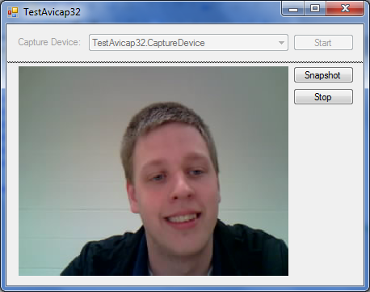
What I did
Start with my camera algorithm to detect my person and their actions
Used my built in camera and the Logitech USB camera
Algorithms
Motion detection
Color/Object detection

Slide 5
Motion Detection
Approach: to detect the person as they are and capture their motion and interpret it
Compare one frame to the next and look for change
Color change with red and try to interpret that change

Slide 6
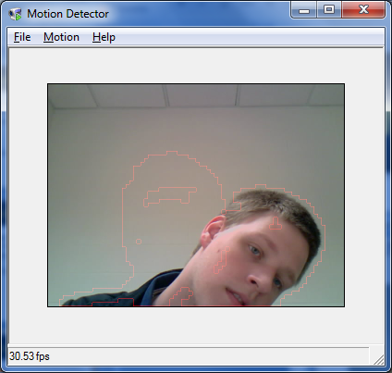
Motion Detection Continued

Slide 7
Continued
Standing still
Moving
Pre packaged software made it very hard to adapt.

Slide 8
Continued: My Own Algorithm

Slide 9
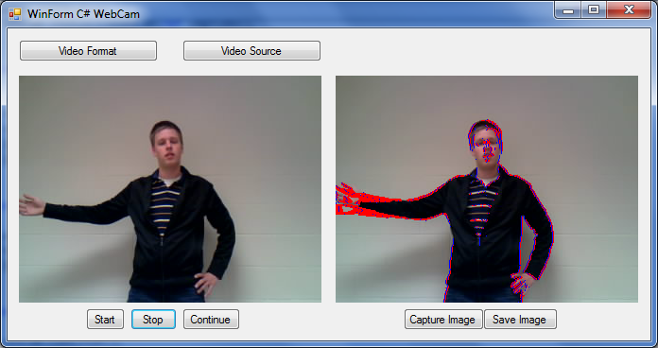
My Algorithm Continued

Slide 10
Color/Object Detection
Detect objects of a particular color
Use multiple colors to aid in understanding
Different color to distinguish points of interest

Slide 11
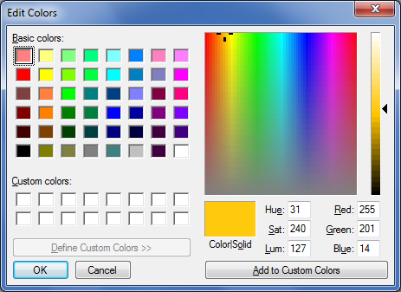
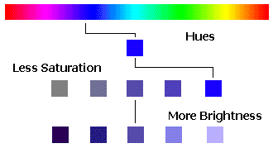
Color/Object Detection: HSV
HSV
Hue
Also known as the overall color
Saturation
Scale of bright color to gray.
High saturation = bright color
Low saturation = gray color
Value
Brightness of the color/Amount of light
More info
http://www.georeference.org/doc/colors_as_hue_saturation_and_brightness.htm

Slide 12
Color/Object Detection: HSV
Concept:
Get the range of hues that are considered to be the colors of my objects and search for those pixels within my captured image for them
Assumptions:
Could detect a yellow object by just looking for the range of hues considered to be yellow

Slide 13
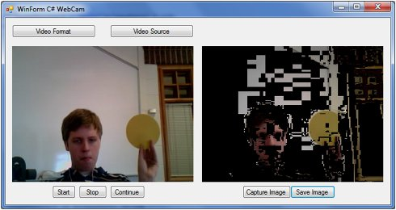
Issues with HSV
Issues:
Bad lighting was causing hues that are not in the yellow range.
Also detecting just a range of hues caused a lot of noise in my image processing.

Slide 14
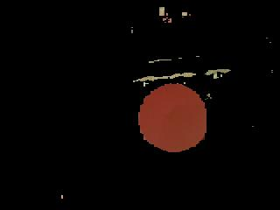
Color/Object Detection: RGB
Go back to basics
What does it mean to be that color?
Start off assuming and refine through testing

Slide 15
Image Processing
Find blobs
Filter out noise
Highlight key info about the blobs
Key points: left, right, top, and bottom points
Color
Interpret significant blobs and connect them accordingly – drawing my stick figure
Error messages throw when interpretation is not as expected
Show result

Slide 16
Demo

Slide 17
Strategies
Build myself a small example so that I can fully understand.
Seek out resources as soon as I have hit a wall that I cannot seem to get around.
Correct and improve my code as I go.
Don’t ignore issues, correct them so they don’t affect later code
Google a lot
I am not the only one who is trying to do something like this

Slide 18
Knowledge & Experience
Key classes that helped
Event programming
Operating systems
Experiences that helped
REU over the summer of 2011 working on images with android.

Slide 19
Adding On
Integrate the KTX humanoid
Save successful poses that were captured for playback
Create a playback feature
Integrate the legs

Slide 20
Advice
Plan and set aside time
Get started and put time in it
Marathon

Slide 21
Questions?

Slide 22
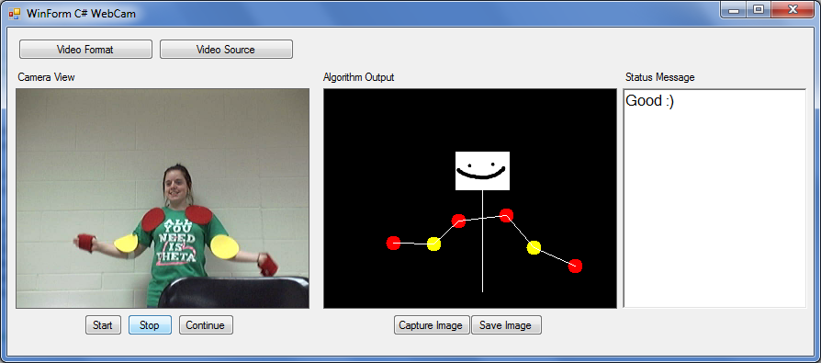
Final Touch
A face. Created by Sam Bonin and added for her helping me as my test subject.
THANKS FOR COMING ☺

